Slide 1
Congratulations!
John Lucas
Ph.D. in Spanish, Class of 2000
President and CEO of International
Student Exchange Programs (ISEP)
2023 Humanities Institute
Outstanding Alumni Award

Slide 2
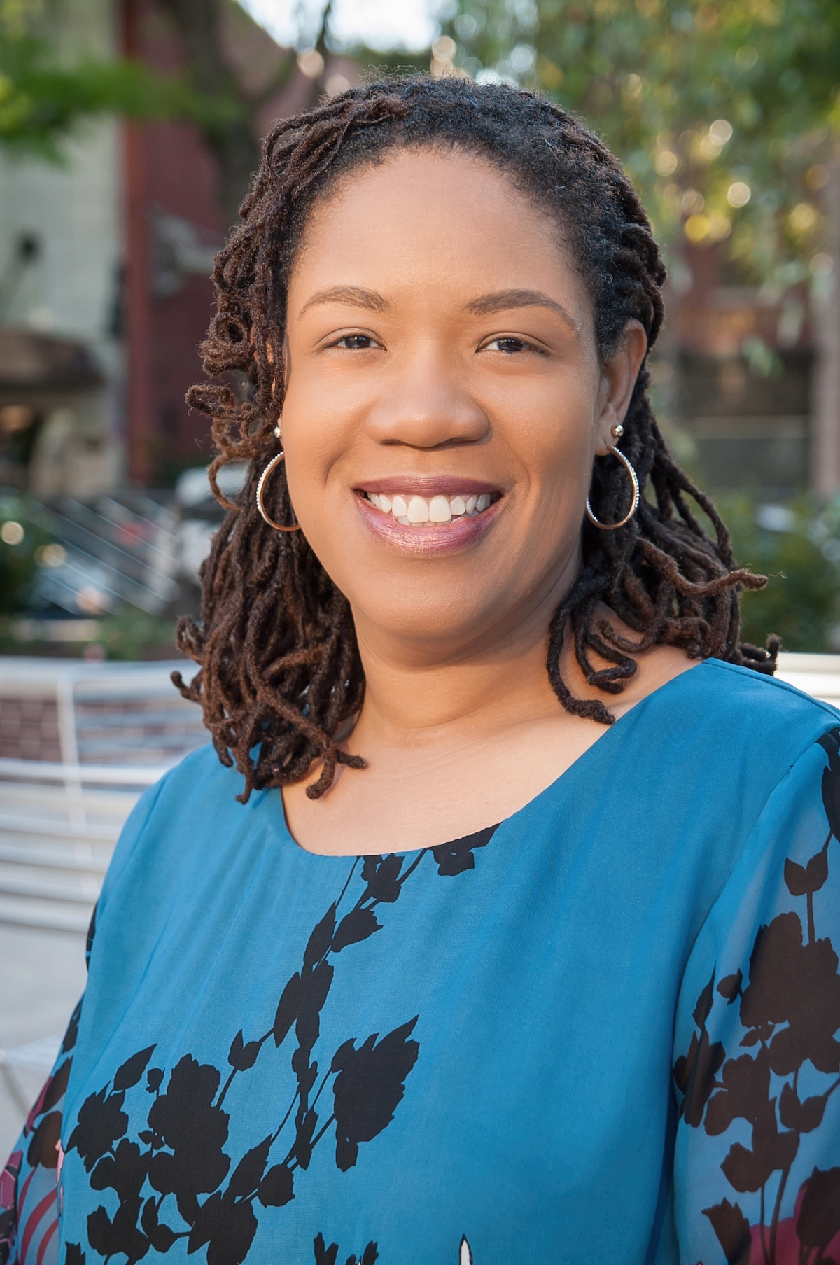
Desegregating Comics
Debating Blackness in the Golden Age
of American Comics
Qiana Whitted
Professor of English and African American Studies
University of South Carolina

Slide 3
Please join us for a reception following the lecture discussion.

